Slide 1
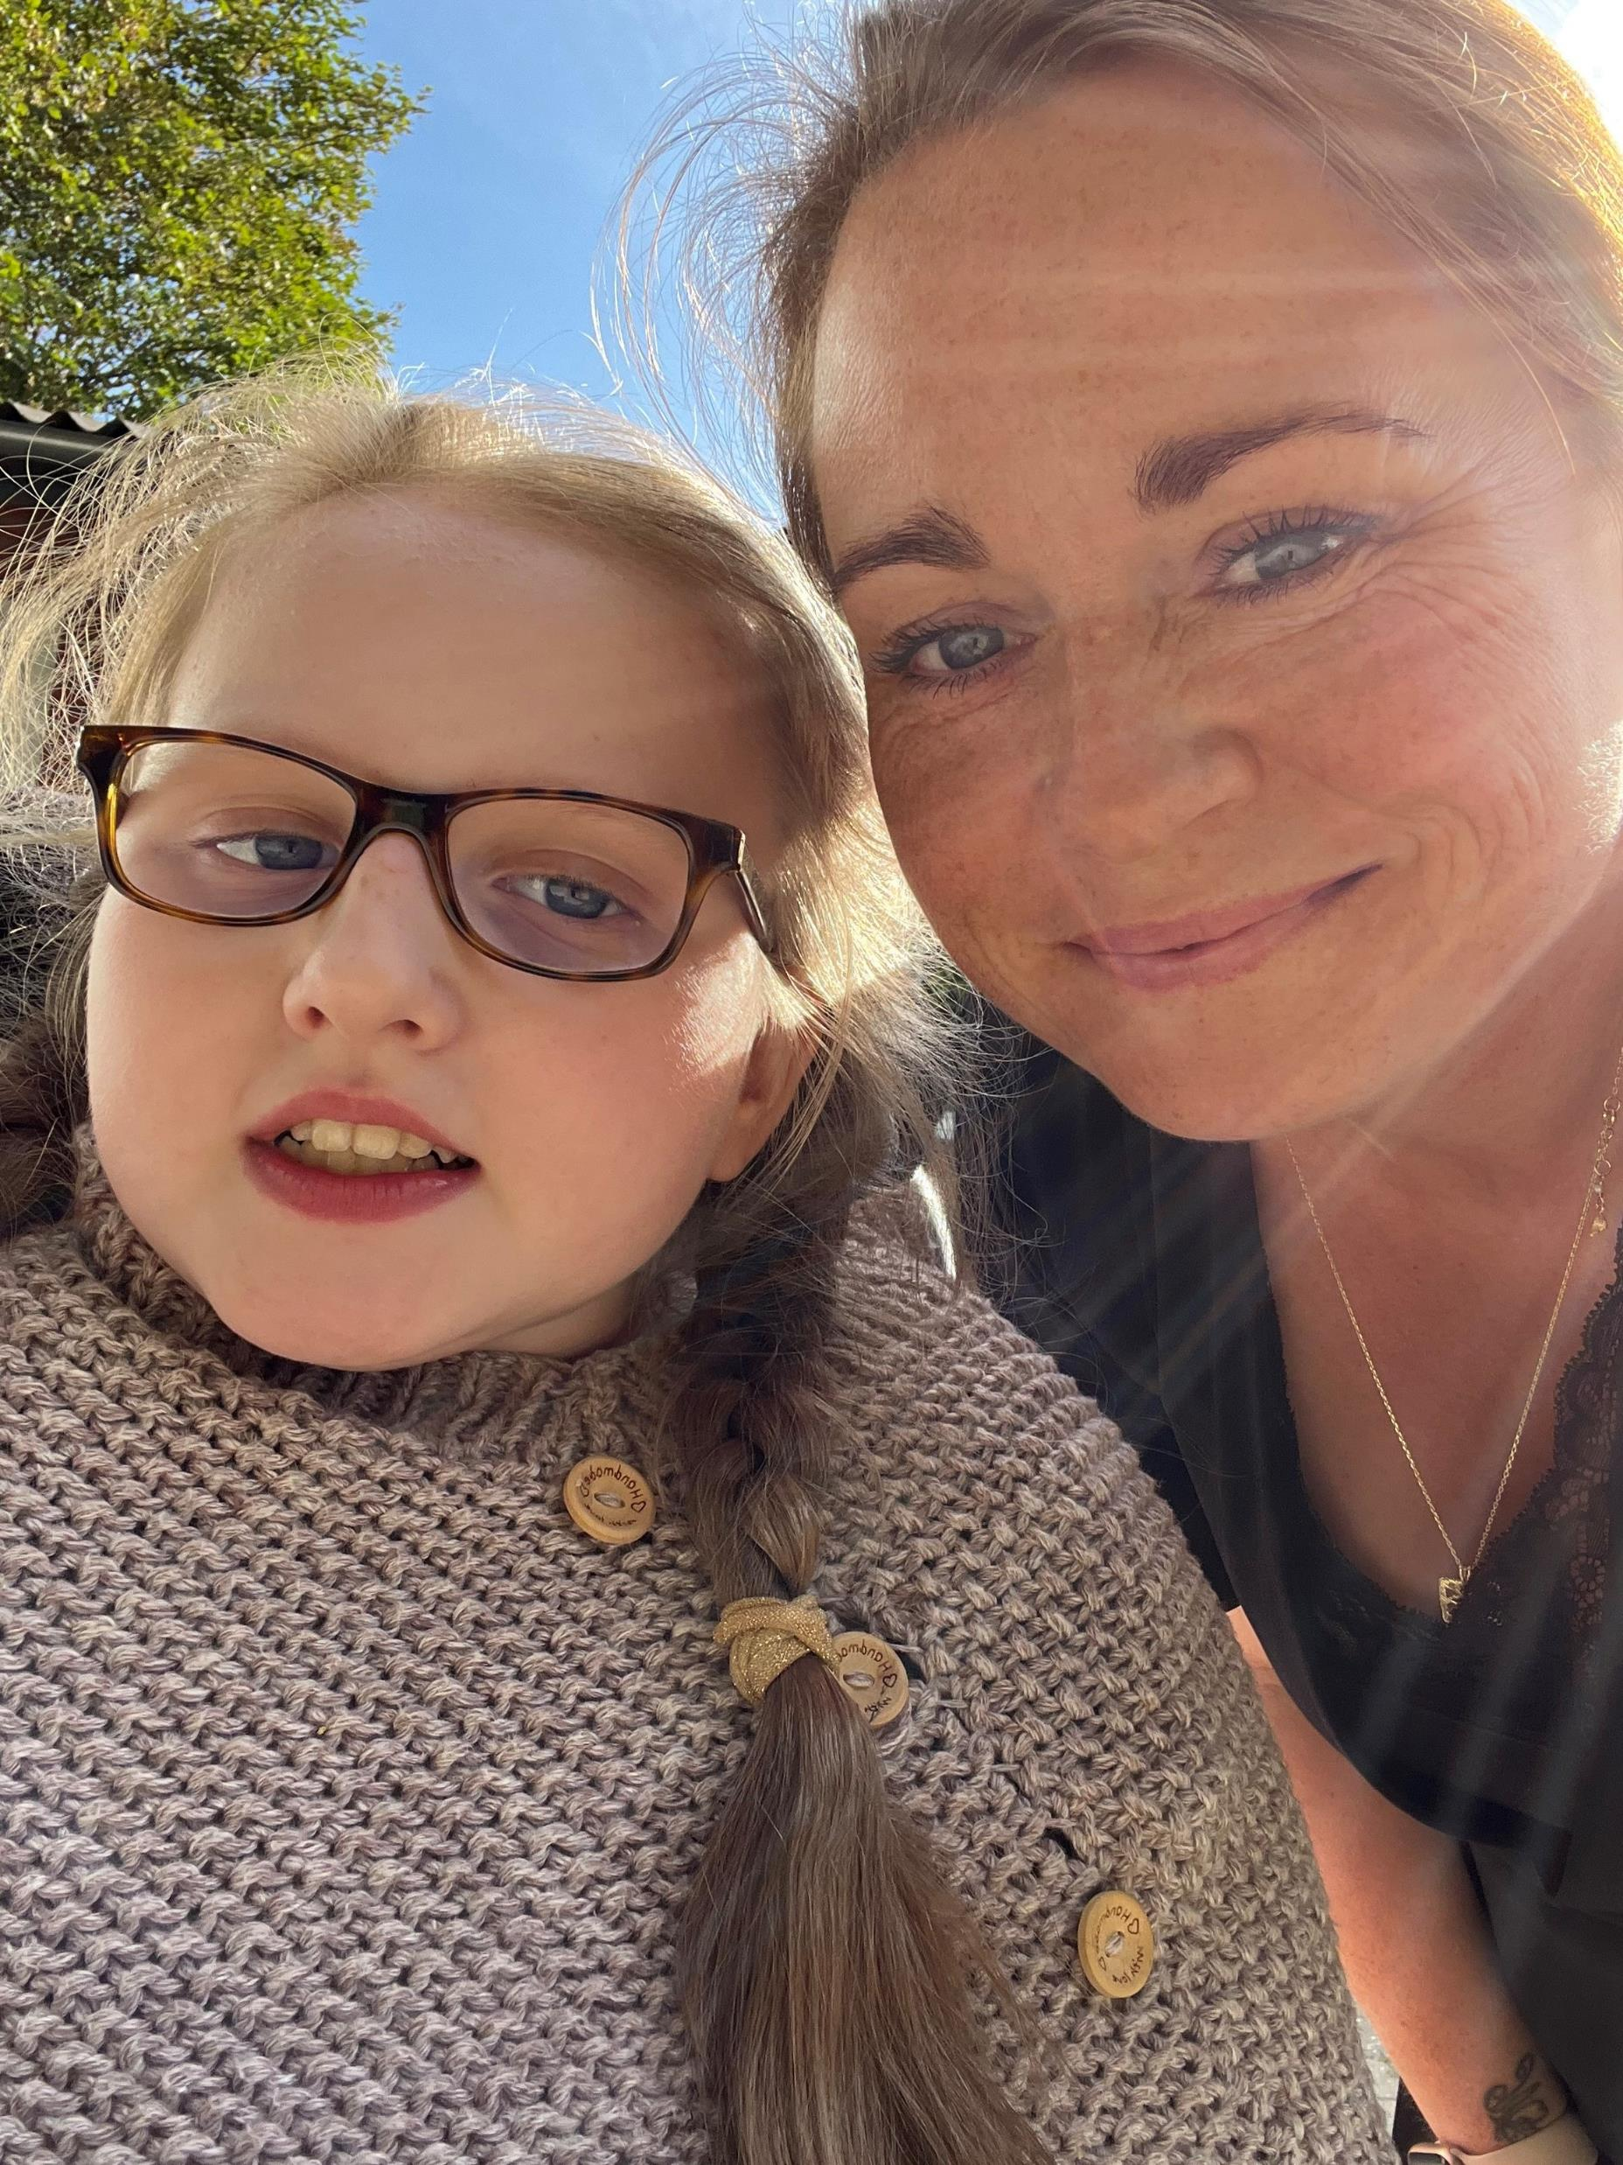
Being a parent of an individual with Rett syndrome – the parents’ experiences
Jane Lunding Larsen, PhD-scholar
The Danish Center for Rett Syndrome

Slide 2
Design
AIM
To explore the experiences of being a parent of an individual with Rett syndrome in a lifelong perspective
METHOD
Semi structured interview – couples or single
Their parenting role: now, retrospective, future
PARTICIPANTS
Interviews: n=13
Individuals with RTT represented: n=12
Parents in total: n=20
Mothers: n=12
Fathers: n=8
Parental age, range (years): 43 – 80
Individuals with RTT, range (years): 13 – 53
Individuals with RTT living with parents n=5
Individuals with RTT living in facility home n=7

Slide 3
Results – Main theme 1
Main theme 1:
Caretaking throughout the years
Chronical homework
Come what may
It has been tough but also enriching
The endless responsibility

Slide 4
Results – main theme 2
Main theme 2:
Distance and Nearness
Creating the right distance
Living together, separately or together apart
I hope I outlive her

Slide 5
Conclusions
Being a parent of an individual with RTT is something that calls for more than an unconditional parental love to carry out, as part of this parenting role also entails actual work – often 24-7
The parents carry a lifelong responsibility and a constant concern for the individual with RTT
It is important to focus on the parents’ mental health, and support them in the process of developing and maintaining a lifelong sustainable parenting role

Slide 6
Thanks to
All the participanting parents for sharing their personal stories
My colleagues at the Danish Center for Rett Syndrome
Anne-Marie Bisgaard, Anne-Katrine Højfeldt, Anne-Lise Ettrup Wahlun Laursen, Kristine Buchhave Mosegaard
My supervisors
Helena Hansson, Anne-Marie Bisgaard, Michelle Stahlhut, Laura Navne

