Slide 1
Activation of X inactivation,
a complex interplay of positive and negative regulators.
Joost Gribnau dept. Developmental Biology, Erasmus MC, the Netherlands

Slide 2
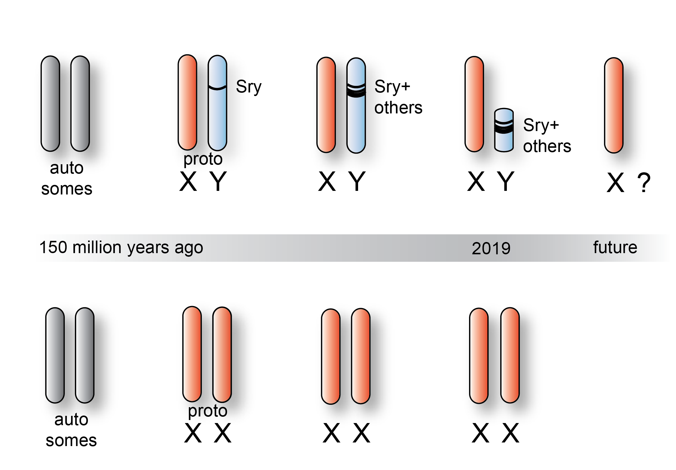
Evolution of sex chromosomes
loss of Y chromosomal genes
O’Leary Science 2013
Notes:
The evolution of our sex chromosomes started around 150 million years ago. It started with the arrival of SRY, the male sex-determining gene, followed by other genes involved in male fertility that landed on the new Y chromosome. This evolutionary process leading to new genes on the Y chromosome in turn let to the degeneration of the Y chromosome. At the moment only a handful of genes are located on the Y chromosome, whereas the X chromosome still harbours more than 1000 genes that have many important functions.

Slide 3
Evolution of sex chromosomes
a future without a Y chromosome?
is gene dosage
important?
Notes:
As a consequence of this degeneration process in principle male cells would express X linked genes at half a level compared to female cells, raising the question whether this dosage difference is a problem.

Slide 4
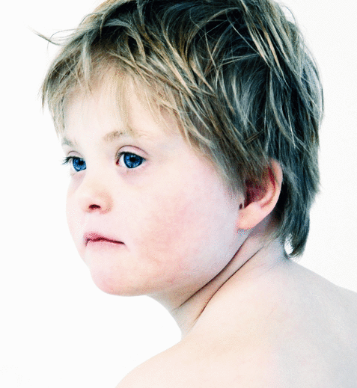
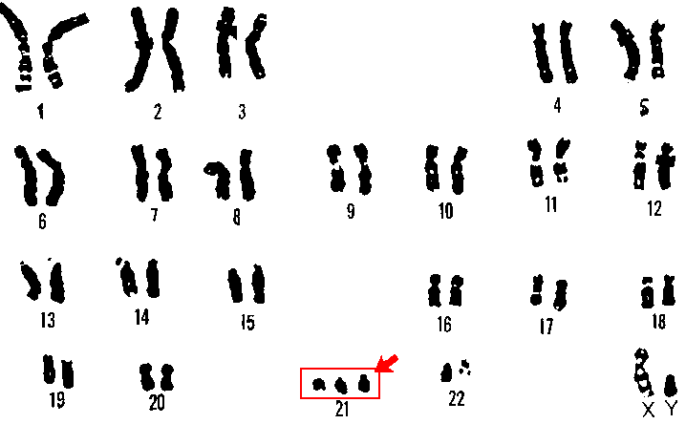
Is gene dosage important?
Down syndrome
Notes:
I just would like to give you one example of a disease, Down syndrome, where the dosage of a very small chromosome 21 is 1.5 times that of what is normal already having a significant effect. So yes dosage does matter.

Slide 5
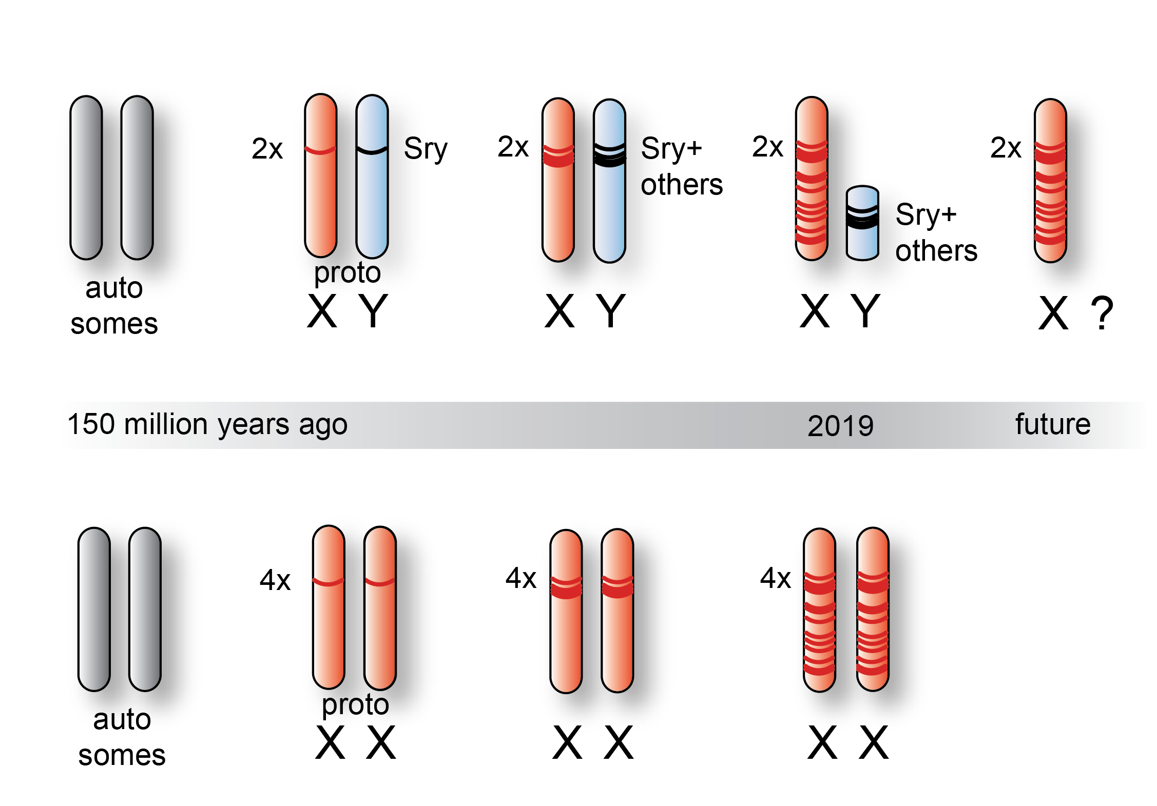
Evolution of sex chromosomes
upregulation of X chromosomal genes
Notes:
It is therefore that during evolution of our sex chromosomes genes that were lost from the Y chromosome where upregulated on the remaining X chromosome. This was important for male cells, but created a problem in female cells that now express X linked genes at double the dose which would be lethal.

Slide 6
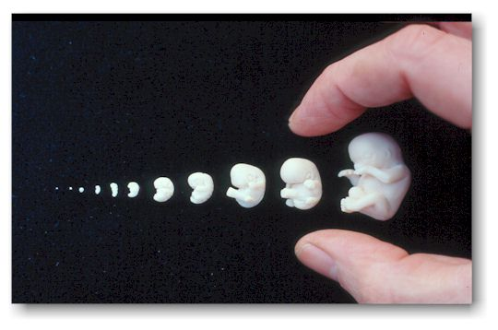
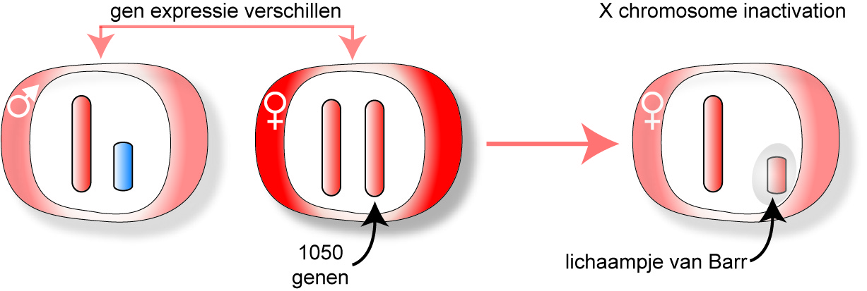
X chromosome inactivation
mammalian specific
gene expression differences
X chromosome inactivation
1050 genes
Barr body
Murray Barr
Susumu Ohno
Mary Lyon
Notes:
It is therefore that another compensatory system evolved to deal with this problem, and that is X chromosome inactivation. This process leads to inactivation of one X chromosome in every female cell that is visible by light microscopy as the Barr body.

Slide 7
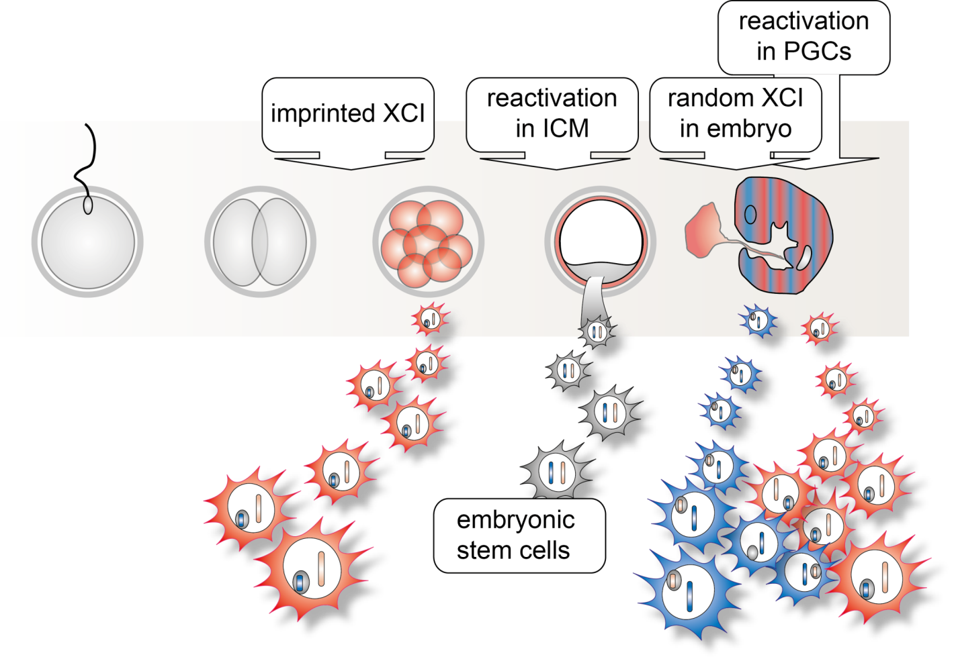
X chromosome inactivation (XCI)
in mouse imprinted and random XCI
Notes:
In mice X chromosome inactivation comes in two flavours; imprinted X chromosome inactivation is initiated very early during development, at the eight cell stage, and leads to inactivation of the X chromosome that was inherited from father. A little later in the blastocyst cells that will form the embryo will reactivate the inactive X chromosome, which is followed by initiation of another roend of X chromosome inactivation which is random with respect to the parental origin of the X chromosome. Once the inactive X chromosome is established this will remain inactive throughout life, also during cell division.

Slide 8
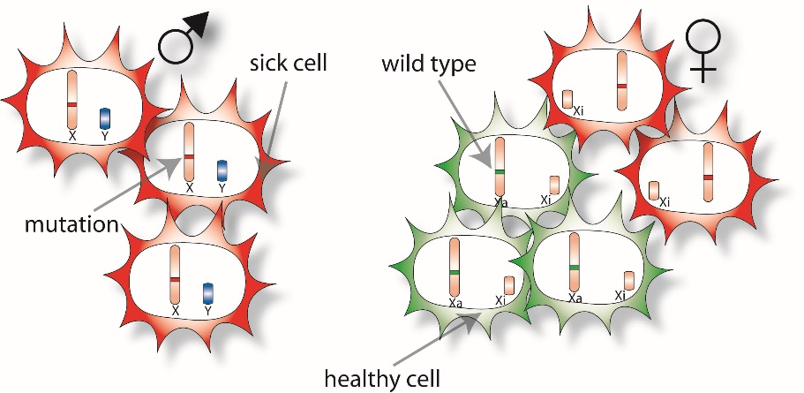
Consequence of XCI
many X-linked diseases are affected by degree of mosaicism
-Rett syndrome, mutations in MECP2 gene
-Fragile X, amplification of CGC repeat in FMR gene
-Fabry disease, mutations in alpha-galactosidase A gene
-Duchenne muscular dystrophy, mutations in DMD gene
-180 X-linked hereditary diseases
Chantal Voskamp and Hegias Mira-Bontenbal, unpublished
Notes:
The evolution of our sex chromosomes has enormous consequences with respect to health and disease. For instance, every mutation that affects the functioning of a gene will lead to a phenotype and possibly a disease in males, as they do not have a reserve copy of this gene. In contrast in women the effect of an X-linked mutation is more difficult to predict.

Slide 9
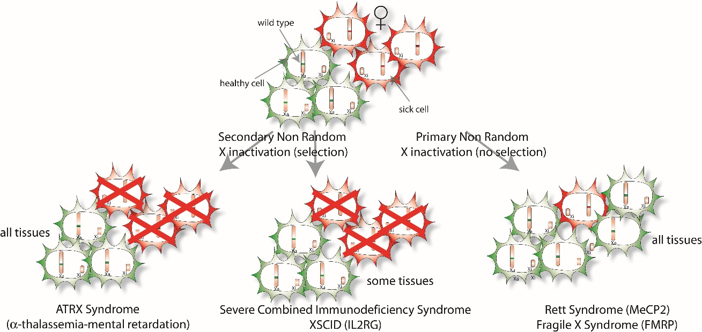
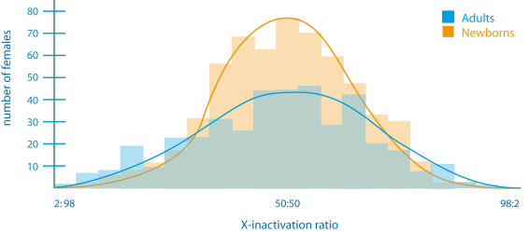
Consequence of XCI
many X-linked diseases are affected by degree of mosaicism
-Rett syndrome, mutations in MECP2 gene
-Fragile X, amplification of CGC repeat in FMR gene
-Fabry disease, mutations in alpha-galactosidase A gene
-Duchenne muscular dystrophy, mutations in DMD gene
-180 X-linked hereditary diseases
(Amos-Landgraf, 2006)
Notes:
Some mutations affect the functioning of a gene that is crucial for survival and these cells are selected against. Other mutations only affect survival of a specific cell type, and these cells may be selected against. Finally, there are mutations in genes where the development of cell types is not affected but where the function of a cell type may be affected, in case of MeCP2 resulting in Rett syndrome. However, here things become complicated because the effect of the mutation is dependent on the randomness of the X inactivation process, which follows a Gaussian curve, where some girls will be much more affected than others.

Slide 10
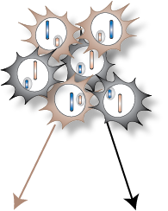
How big is the patch size in human?
De Hoon et al., J. Med. Genet. 2015
Notes:
Some time ago we tried to understand this skewing of X chromosome inactivation, and whether we can predict this by examining skewing of X inactivation in accessible tissues such as blood, swabs and hair follicle and relating this to skewing in organs of several women that we studied. What this study showed is yes the skewing ratio’s correlate but in several women there is a clear deviation in specific organs, and that there is not a good predictor for skewing. In addition, we studied the patch size in women. In calico cats we can clearly see the consequence of X chromosome inactivation and clonal propagation, where each patch is build up of the progeny of a single cell. What our study shows is that in women the patch size is very small in several organs that we studied (very different from the calico cat).

Slide 11
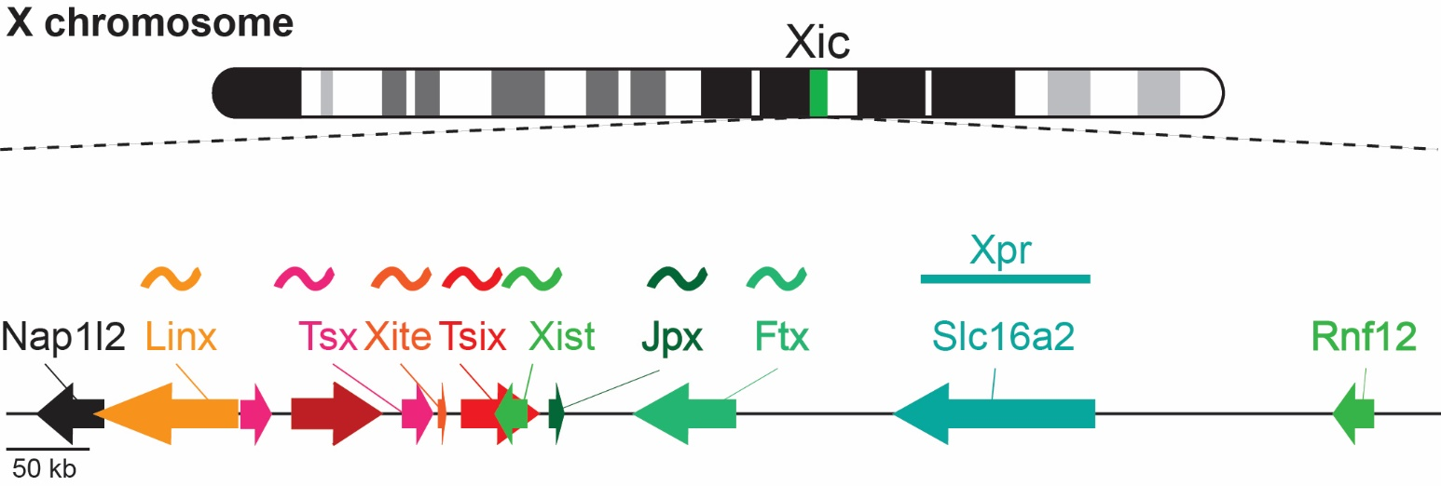
Genes involved in XCI
the X inactivation center (Xic)
Tsix
Xist
Borsani et al., 1991 Brown et al., 1992
Brockdorff et al., 1991 Lee et al., 1999
Brown et al., 1991 Ogawa and Lee, 2003
Brockdorff et al., 1992 and many more!
Notes:
X chromosome inactivation is regulated by a specific region on the X called the X inactivation center. Located within this XIC XIST is the major player of X chromosome inactivation. XIST encodes a non-coding functional RNA that is transcribed from the inactive X chromosome and coats the X chromosome.

Slide 12
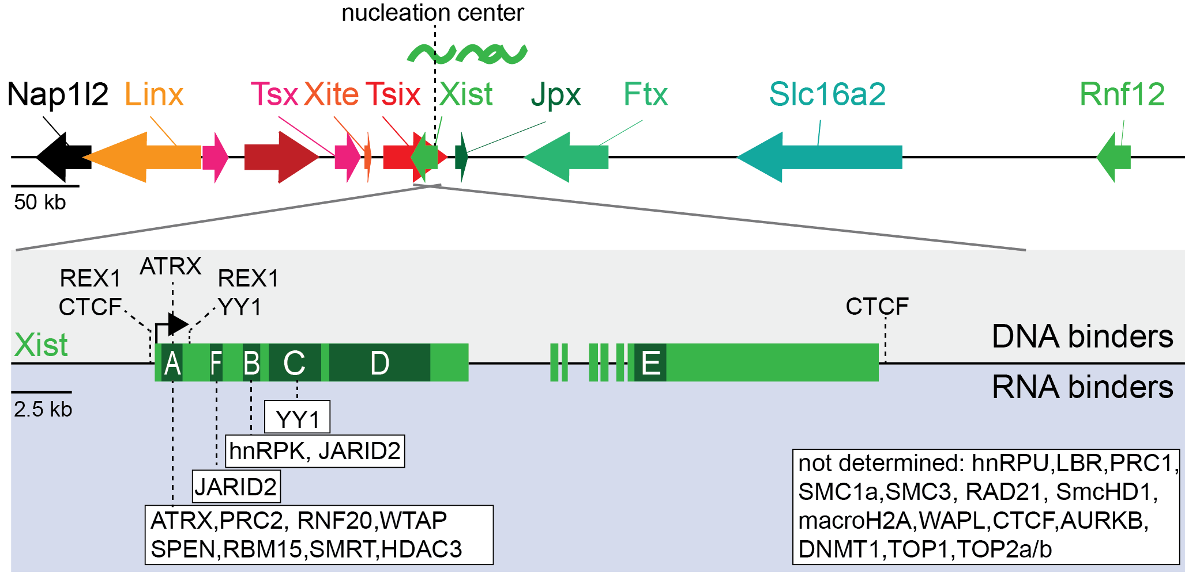
Xist mediated silencing
a complex road to the inactive X (Xi)
Work of many!
Notes:
XIST contains many repetitive regions that are involved in recruitment of protein complexes that are involved in silencing of X-linked genes in cis.

Slide 13
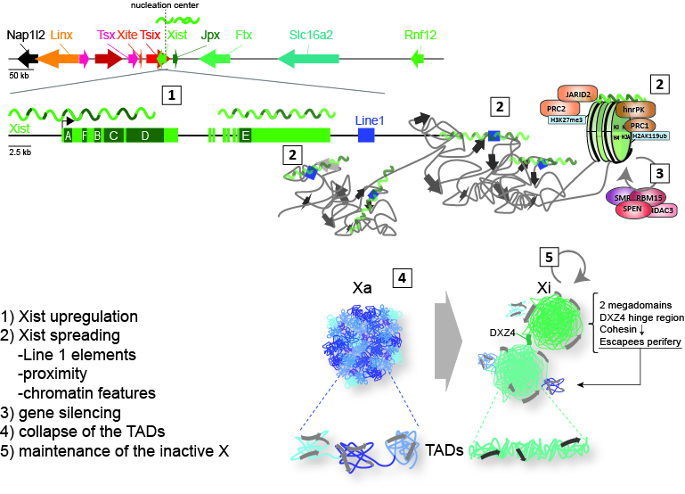
X chromosome inactivation
an overview
Notes:
X chromosome inactivation starts with upregulation of XIST, which starts to spread in cis recruiting protein complexes involved in gene silencing. As a consequence regions where active genes reside (the higher order chromatin structure) collapse and silenced genes end up in inactive regions coated with XIST.

Slide 14
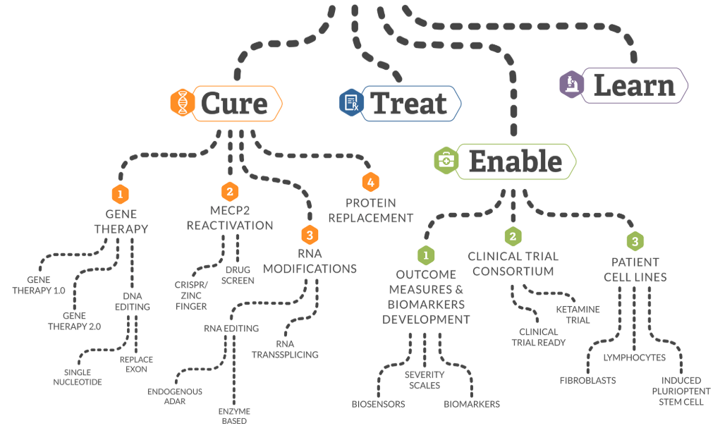
Rett Syndrome (RTT) strategies to treat RTT
Notes:
The work that I present today has been sponsored by the RSRT. Within the RSRT there are different lines of research aimed at developing gene therapy approaches to tackle Rett syndrome, a line that focusses on reactivation of MeCP2 located on the inactive X chromosome, a line aimed at development of therapies based on alternative splicing and RNA editing, and a research line focussing on protein replacement therapy.

Slide 15
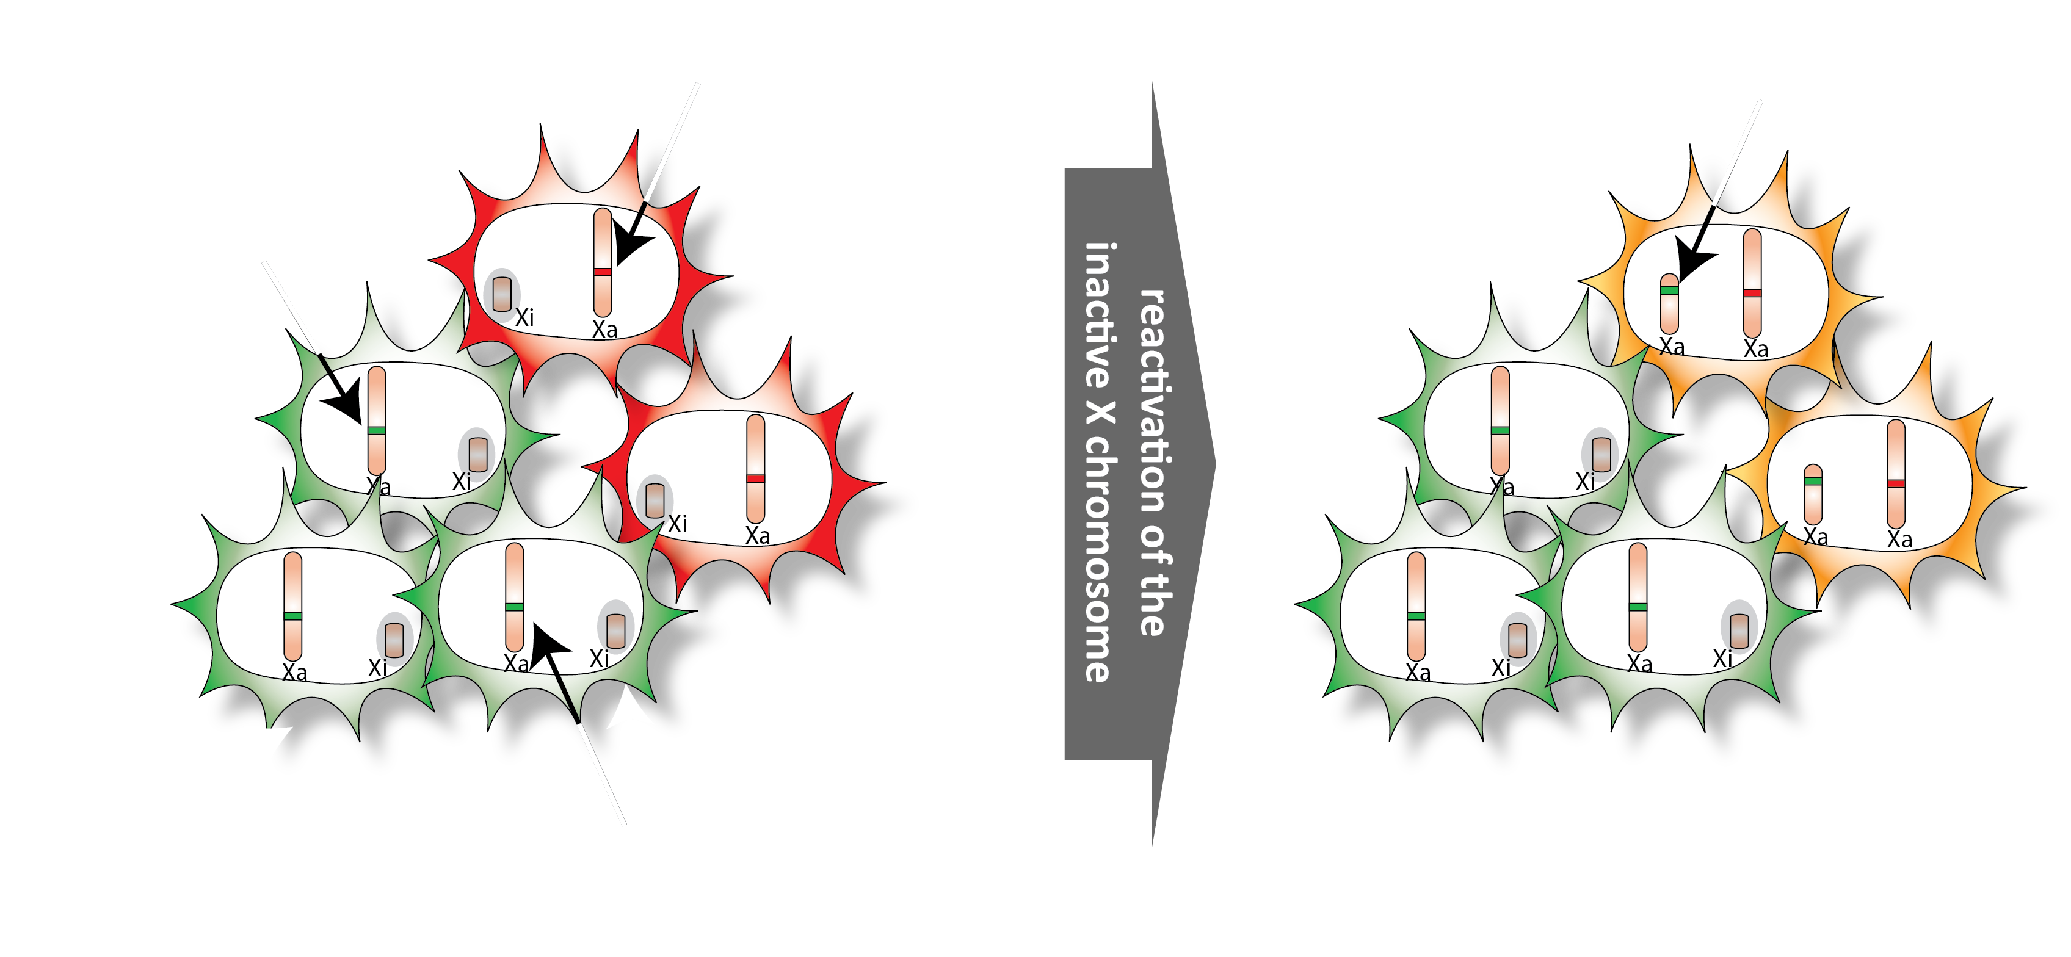
2
Notes:
We have been involved in the team that focusses on X chromosome reactivation. The idea behind this approach is that the sick cells (shown in red), harbour a unaffected allele on the inactive X chromosome. Reactivation of this silent copy could rescue the phenotype of this diseased cell. The advantage of this approach is that reactivation leads to levels that are physiologically normal and is not expected to lead to over-expression of MeCP2.

Slide 16
Rett Syndrome (RTT) a mouse model for MeCP2 reactivation
Hegias Mira
Hegias Mira-Bontenbal, with Bedalov lab.
Notes:
The problem is that so far there have been no good model for studying X reactivation, and most screens have been performed on fibroblasts that are very different from the cells that are affected in Rett syndrome. We therefore set out to generate a mouse model that has all the components to study X reactivation and can be used for compound screens.

Slide 17
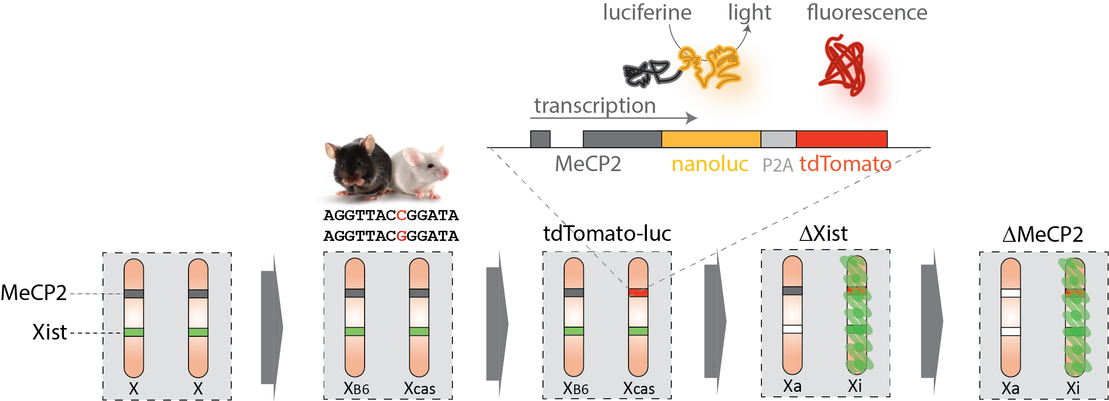
Rett Syndrome (RTT) MeCP2 reactivation
Hegias Mira-Bontenbal, with Bedalov lab.
Notes:
The model starts with a polymorphic back ground where the two X chromosomes are very different (1 SNP every 300 bp, meaning many differences per gene) which allows us to study reactivation of all X linked genes. We also introduced a reporter of MeCP2 activity by introducing a nanoluciferase and tdTomato transgene fused to MeCP2 using the Crispr/Cas9 technology. We als introduced a mutated Xist allele forcing inactivation of the reporter, and finally introduced an MeCP2 mutation so that these cells resemble Rett cells.

Slide 18
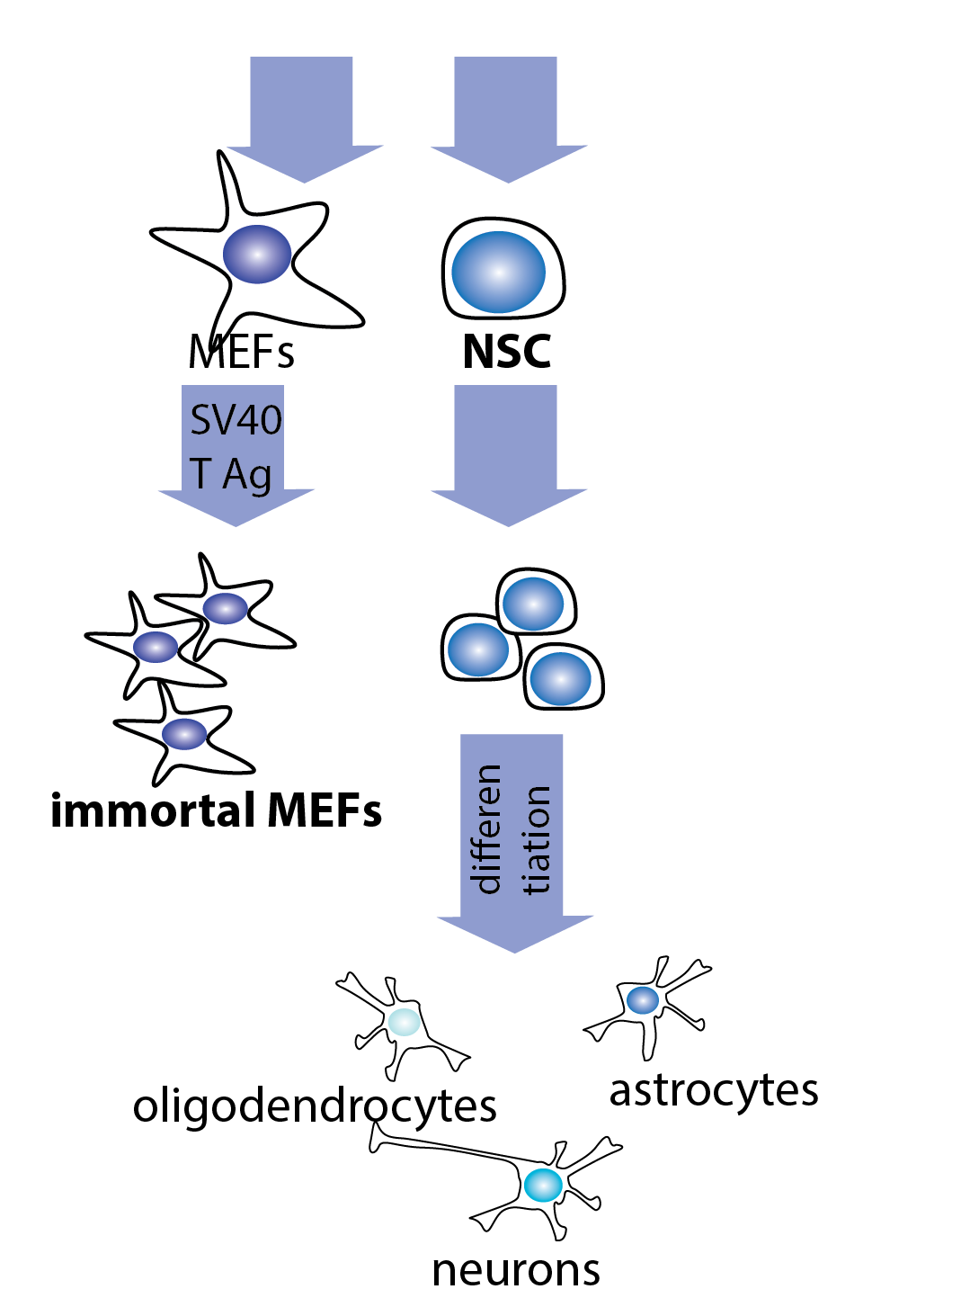
Rett Syndrome (RTT) MeCP2 reactivation
cell lines for high
throughput compound screens
Hegias Mira-Bontenbal, with Bedalov lab.
Notes:
The idea was to generate this mouse and then generate immortalized mouse embryonic fibroblasts (MEFs) and neural stem cells (NSCs) that are immortal and can be used in large compound screens, with the idea that if we add a compound that reactivates the MeCP2 reporter we will measure this through increased luciferase activity.

Slide 19
Rett Syndrome (RTT) MeCP2 reactivation
Hegias Mira-Bontenbal Stem Cell Reports 2022
Notes:
We generated mice with different phenotypes and isolated neural stem cells with a wildtype genotype, NSCs with an inactivated MeCP2-nanluc-tdTomato reporter with or without a mutated MeCP2 gene. And Control lines where one or two MeCP2-nanluc-tdTomato alleles are active. Our NSC lines were also able to differentiate into TUJ-1-expressing neurons, GFAP-expressing astrocytes, and OLIG2-expressing oligodendrocytes, confirming that these are stem cells.

Slide 20
X-reactivation mouse model
tdTomato activity
Hegias Mira-Bontenbal Stem Cell Reports 2022
Notes:
We then tested by FACS analysis the activity of the reporter. As expected in cells that do not harbour the reporter or in cells where the reporter is located on the inactive X chromosome we do not find any activity of the tdTomato transgene. In contrast, the control lines where the reporter is located on the active X chromosome display tdTomato expression.

Slide 21
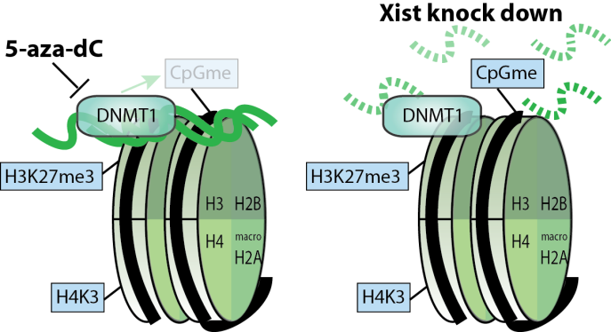
X-reactivation mouse model
5-aza-dC and Xist KD studies
Hegias Mira-Bontenbal Stem Cell Reports 2022
Notes:
We then tested whether factors known to interfere with X chromosome inactivation were able to reactivate our reporter transgene. 5-aza-dC interferes with gene silencing by depleting DNA methylation, whereas depletion of Xist might facilitate the reactivation. We grew our cells in the presence of 5-aza-dC and simultaneously knocked down Xist activity in wild type control cells and cells with the MeCP2-nanluc-tdTomato reporter located on the inactive X chromosome. This experiment shows that 5-aza-dC treatment results in auto-fluoresence, but also shows a little bulge (highlighted with an arrow) indicating cells that reactivated the inactive MeCP2 allele. We also measured the nano-luciferase activity which showed an additive effect of both treatments, but also shows that we are still a hundred fold below the expression of MeCP2 on an active X chromosome.

Slide 22
Rett Syndrome (RTT) MeCP2 reactivation
Hegias Mira-Bontenbal Stem Cell Reports 2022
Notes:
By FACS we sorted different cell fractions that showed low, medium and high tdTomato activity, and RNA-seq analysis confirmed upregulation of MeCP2 and down regulation of Xist on the Cast X chromosome that is normally inactive.

Slide 23
Rett Syndrome (RTT) MeCP2 reactivation
Notes:
We next checked the expression of other genes on the inactive X chromosome. This analysis showed that next to MeCP2 many other genes respond to the 5-aza-dC/Xist knock down treatment, and that these genes are scattered along the X chromosome.

Slide 24
Rett Syndrome (RTT) MeCP2 reactivation
Hegias Mira-Bontenbal Stem Cell Reports 2022
Notes:
In depth analysis of features that may explain reactivation behaviour of all these genes indicate that
genes within specific regions are more likely to be reactivated,
genes that are reactivated show more SINEs and les LINEs in their vicinity
and that genes that are prone to be reactivated show more chromatin modifications associated with gene activity on the active X chromosome.

Slide 25
MeCP2 reactivation
conclusions
5-aza-dC + Xist KD mediated X-reactivation leads to a small fraction of cells that display reactivation of the inactive MeCP2 gene.
The level of MeCP2 expression from the reactivated MeCP2 allele is very low.
5-aza-dC + Xist KD mediated X-reactivation leads to reactivation of many other X-linked genes.
X-reactivation corresponds with higher order chromatin structure, SINE density and gene activity on the active X.
A mouse model for X reactivation screens, licensed by 3 companies for compound screens.
Future:
Reactivation of many other genes might be detrimental.
Therefore we may opt for targeted strategies using inhibition of Xist and Crispr mediated activation of MeCP2.
Notes:
Based on our findings we conclude that:
5-aza-dC + Xist KD mediated X-reactivation leads to a small fraction of cells that display reactivation of the inactive MeCP2 gene.
The level of MeCP2 expression from the reactivated MeCP2 allele is very low.
5-aza-dC + Xist KD mediated X-reactivation leads to reactivation of many other X-linked genes.
X-reactivation corresponds with higher order chromatin structure, SINE density and gene activity on the active X.
A mouse model for X reactivation screens, licensed by 3 companies for compound screens.
Future:
Reactivation of many other genes might be detrimental.
Therefore we may opt for targeted strategies using inhibition of Xist and Crispr mediated activation of MeCP2.

Slide 26
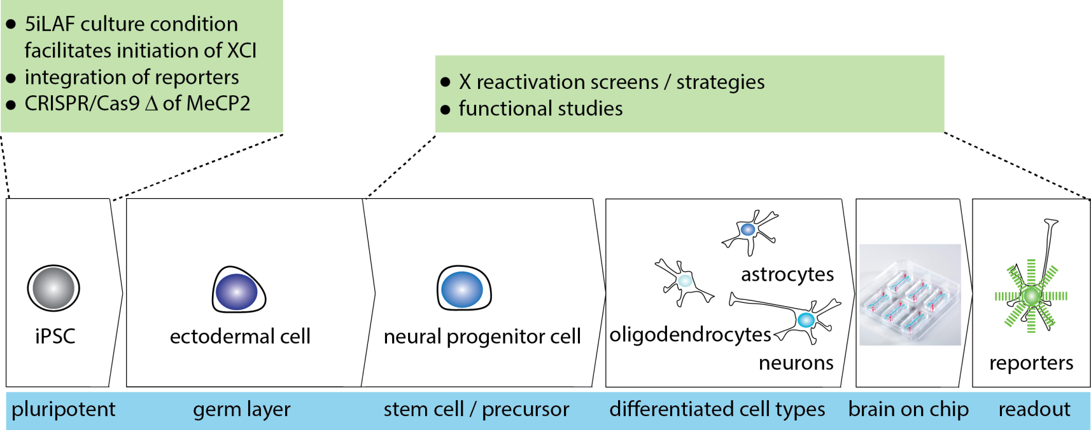
MeCP2 reactivation
translation to human
Cristina Gontan
Notes:
At the moment we are generating human model systems to study X-reactivation. Cristina Gontan who leads this research group generated human iPS cells with a similar MeCP2 activity reporter, and differentiated these into neurons but also brain organoids.

Slide 27
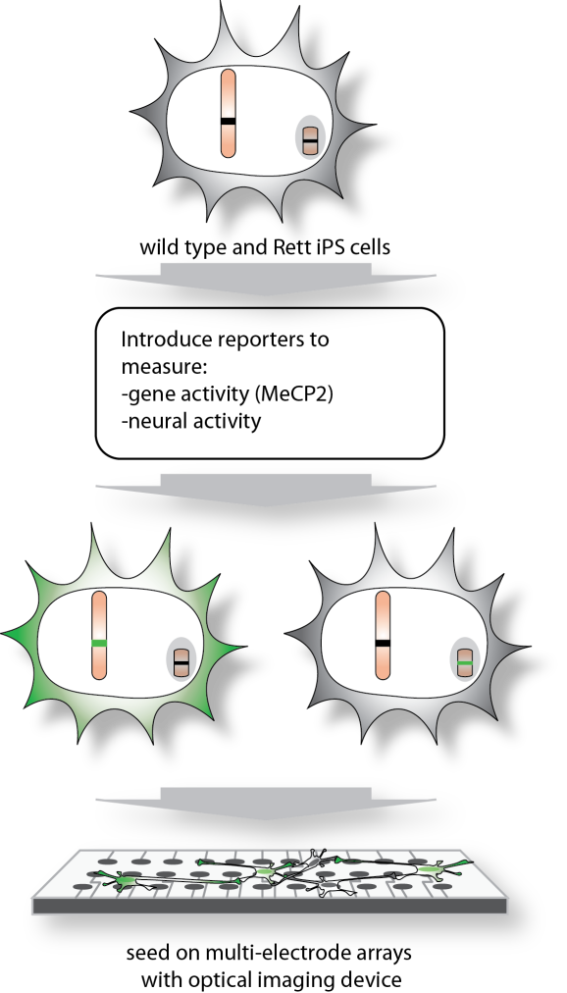
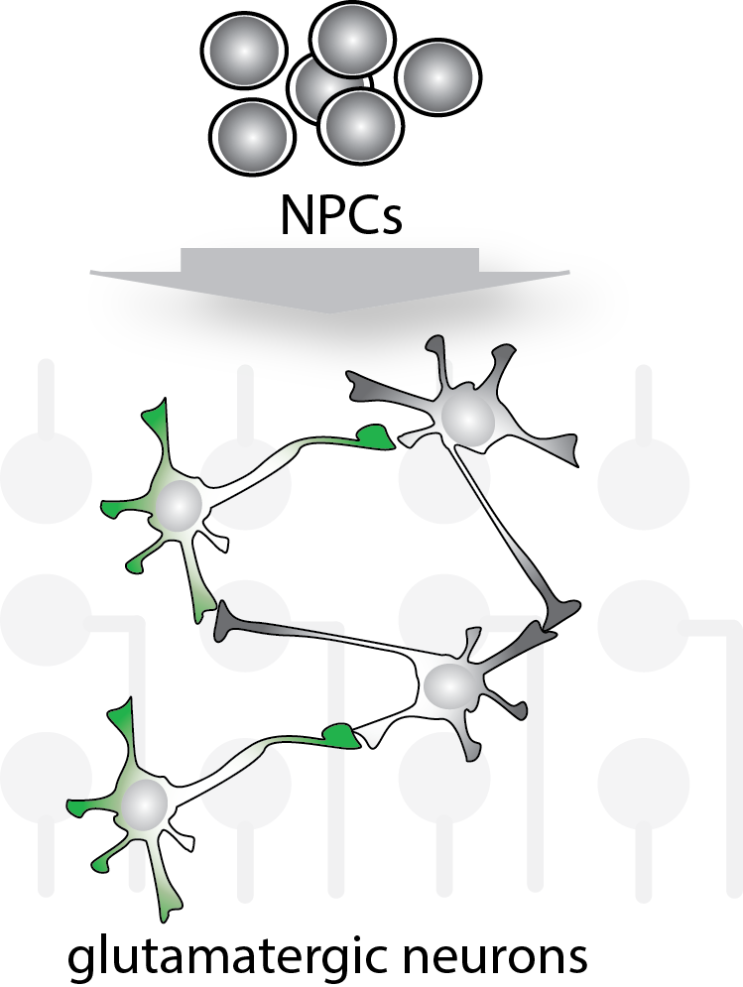
iPS cells as models for Rett syndrome to study and treat disease
experimental setup
Cristina Gontan
Generate of mature neurons
-combinations of cells
-relate genotype to phenotype
-nr of synapses, activity, ratio
-test of compounds
Notes:
Here we will study neural activity in cultures with neurons that are MeCP2 wildtype and knockout.

Slide 28
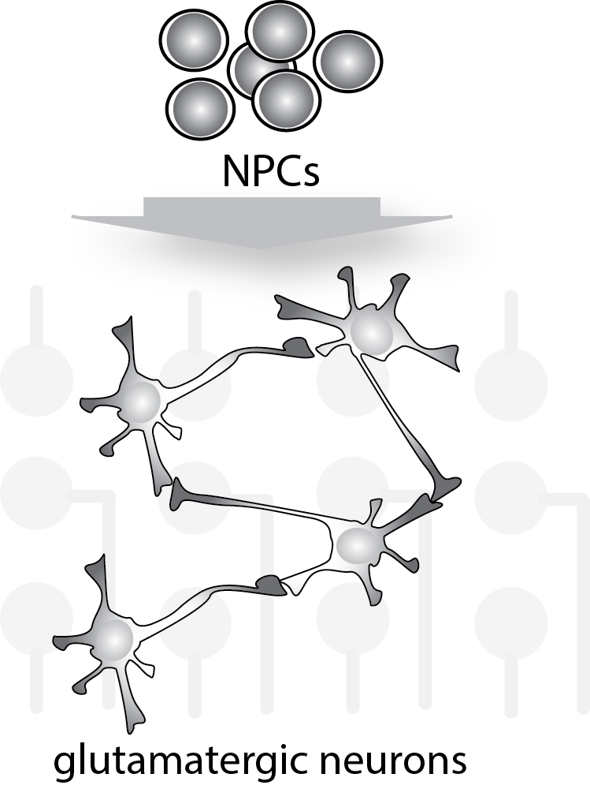
iPS cells as models for Rett syndrome to study and treat disease
experimental setup
Cristina Gontan
Generate of mature neurons
-combinations of cells
-relate genotype to phenotype
-nr of synapses, activity, ratio
-test of compounds
Notes:
And will measure the activity on micro-electrode arrays.

Slide 29
iPS cells as models for Rett syndrome to study and treat disease
experimental setup
Cristina Gontan
Generate of mature neurons
-combinations of cells
-relate genotype to phenotype
-nr of synapses, activity, ratio
-test of compounds
measure
Notes:
Finally, in this setting we could like to screen and validate compounds.

Slide 30
Erasmus MC, Dept
Developmental Biology
Cristina Gontan Pardo
Teresa Robert Finestra
Jeffrey Boeren
Catherine Dupont
Ruben Boers
Joachim Boers
Hegias Mira Bontebal
Marieke van Leeuwen
Samuel Luchsinger
Olivier Schaffers
Former members:
Kim Monkhorst
Iris Jonkers
Eskeatnaf Mulugeta
Stefan Barakat
Friedemann Loos
Agnese Loda
Joke van Bemmel
Bas de Hoon
Cheryl Maduro
Sarra Merzouk
Biomics facility:
Wilfred van IJcken
Beatrice Tan
Evelyne Wassenaar
Eveline Rentmeester
Mehrnaz Ghazvini
Joanna Carvalho
Camilla Bragonzi
+MSc students!
Collaborators:
Edith Heard (EMBL)
Claire Rougeulle (Paris)
Vincent Pasque (Leuven)
Funding organizations:

